Slide 1
MacroFinance Crash of 2008
Getting to the Root of the Cause

Slide 2
Landmark Events in Crisis
Winter 2006-07
  Real Estate Prices Fall
Summer 2007
  Countrywide Mortgage fails
  Fannie Mae, Freddie Mac in distress
Summer-Fall 2007
  Northern Rock (British lender) fails
  Spread between T-Bill and LIBOR grows large
  Recession begins
Spring 2008
  Bear Stearns fails
Summer 2008
  Oil & other commodity prices spike
September 2008
  Lehman Bros. fails
  AIG near failure
  Stock market plunges
  LIBOR; Commercial Paper markets freeze (“wholesale money markets”
  Wachovia (bank) fails
  Fed begins/expands unusual interventions

Slide 3
Financial Stress Leading up to Sept 08
TED = T-Bill Rate – LIBOR (usually equal)
KCFSI = Kansas City Fed Financial Stress Index

Slide 4
Relative Size of Financial & Macroeconomic Losses

Slide 5
Key Questions
Cause/Effect
  What was the gasoline, what was the match?
Responses
  Get rid of gasoline?
  Get rid of matches?
  Store in safer places?

Slide 6
Fuel for the Crash
Home Mortgage Debt = 1/3
Commercial Loans
    Amplified by implied or explicit guarantees to banking/financial system (“moral hazard”)
      Fed/Fannie-Freddie
    Amplified by competition for loans
    Amplified by gov’t push for loans to non-qualifiers
DEBT, DEBT, DEBT

Slide 7
DEBT, DEBT, DEBT

Slide 8
Mortgage Debt Part of the Story,
Commercial Lending a Bigger Part

Slide 9
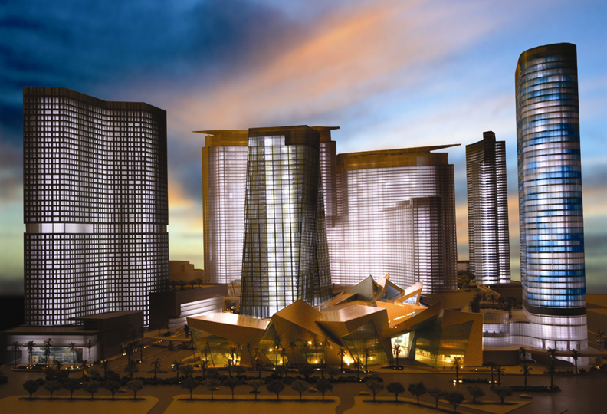
“Poster” Project for Commercial (non-mortgage) Debt (Artist Image)
$11 Billion City Center Project
Las Vegas – MGM Mirage
Bank Loan/Bond Funded

Slide 10
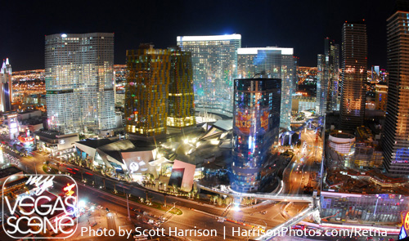
The Real Thing

Slide 11
Limits of Debt Constraints
Economy-wide Budget Constraint:
Income + Debt Value = Debt Payments + Consumption
Over the long run:
  Debt Value = Debt Payment or else “Ponzi Scheme”
  Implies Consumption must be based on Income (not debt)

Slide 12
Why So Much Attention on Mortgage Debt?
Mortgage market was the first “on fire”
  Many interpreted as “the cause”
Mortgage debt traded daily in markets
  Quickly reflecting change in valuations
  Info on this appearing by 2007
Commercial bank loans not traded in markets
  Change in value reported slowly by banks over time
  Info on this not really appearing until into 2009

Slide 13
MATCH FOR THE FUEL
Falling real estate prices & mortgage defaults beginning in 2006-2007
    Lenders not receiving expected payments
    Begins chain of financial firms in trouble because not receiving payments from other firms
Oil Price (and many other basic commodities) Price Spikes of 2008
  Oil from $70/barrel to $145/barrel
  Oil price spikes leading all but 1 post WWII recession

Slide 14
Limiting Future Problems?
LIMIT “SYSTEMIC RISK”
MANY IDEAS:
  Stricter regulation including more owner “capital” per loan
  Limit financial firm size
  Insurance fees tied to risks of lending
  Eliminate subsidies to housing lending like Fannie/Freddie
Bottom Line: whatever the specifics, systemic risk only reduced through substantially less lending
Tradeoff: Benefits of lending-Risks of lending

Slide 15
Causes of Debt/GDP Expansion:
Cheap Credit

Slide 16
Causes of Cheap Credit:
Public Sector Backing of Debt
(Fannie Mae, Freddie Mac, and others)

Slide 17
Cheap Credit:
Foreign Investors Liked U.S.

Slide 18
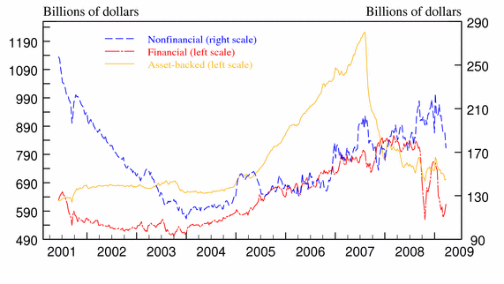
Causes of Cheap Credit:
Expansion of “Wholesale” Money Markets

Slide 19
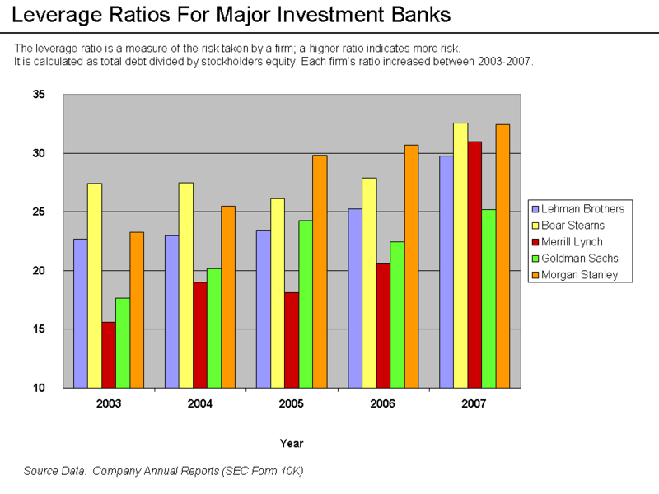
Cheap Credit:
Wholesale Market Expansion

Slide 20
Cheap Credit:
Wholesale Market Expansion
Securitization, e.g. CDOs
  Pooling mortgage (other debt) risk (CDOs, SPVs)
Credit Insurance
  Transferring Risk (CDS)

Slide 21
Cheap Credit:
Fed Responsible?

